Slide 1


Real-Time Rendering
Carl Jones
Lighting

Slide 2

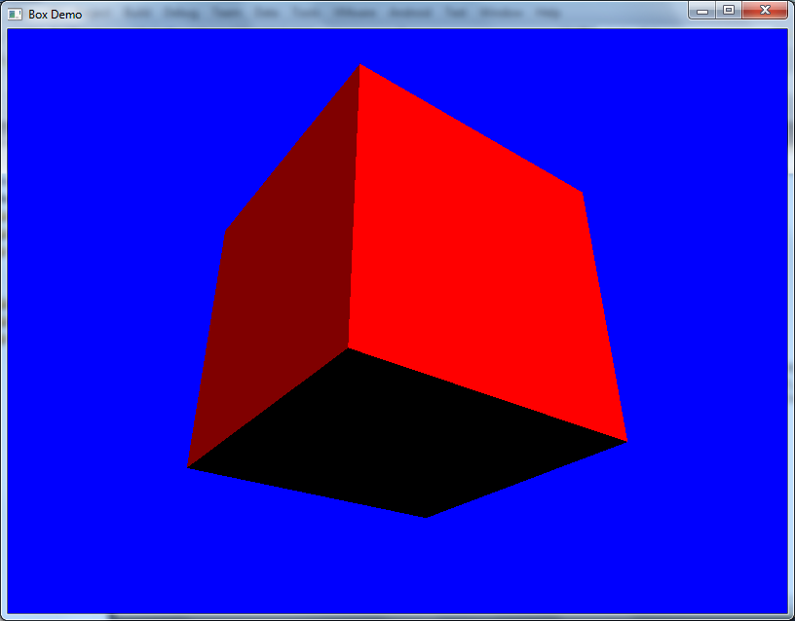
Basic Diffuse Light Shader

Slide 3
Diffuse lighting
Intensity is proportional to cos(a)
If the light and normal vectors are normalized
N.L = cos(a)
AmbientColour*= AmbientIntensity;
DiffuseColour=
(DiffuseIntensity * DiffuseColour) * saturate(dot(L,N));
Colour = AmbientColour+ DiffuseColour;
N
L
a
Diffuse

Slide 4
Phong / Blinn-Phong lighting
R = 2 * (N.L) * N - L
H = normalize(L + E);
N
H
N
R
L
H
L
E
E
b
b
Phong
Blinn-Phong

Slide 5
Specular lighting (Phong)
Intensity is proportional to cos(b)^{n}
If the R and V vectors are normalized R.V = cos(b)
SpecularColour= (SpecularIntensity * SpecularColour) * pow(saturate(dot(R,V),n));
Colour=AmbientColour+DiffuseColour+SpecularColour

Slide 6
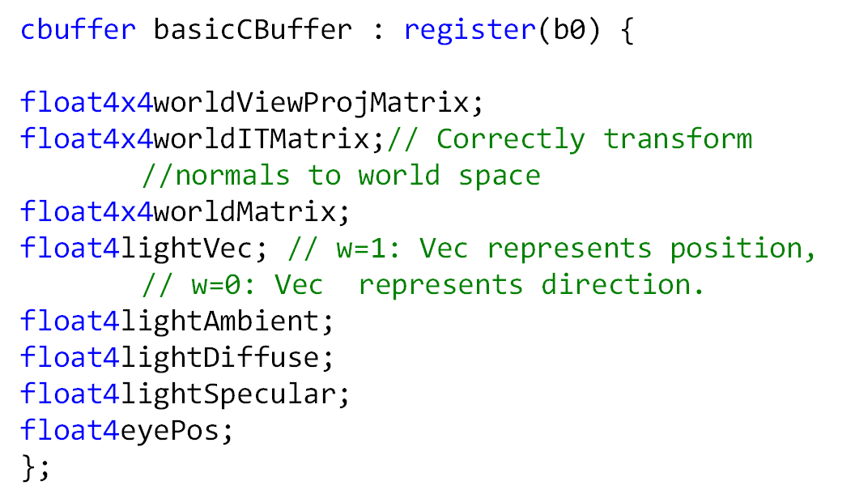
Globals

Slide 7
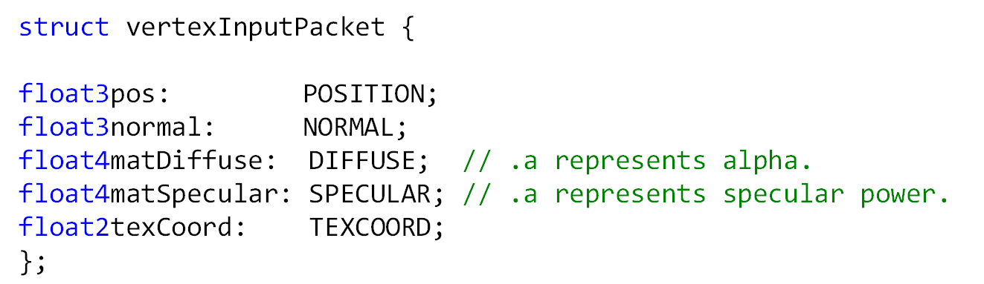
Phong Vertex Shader Input

Slide 8
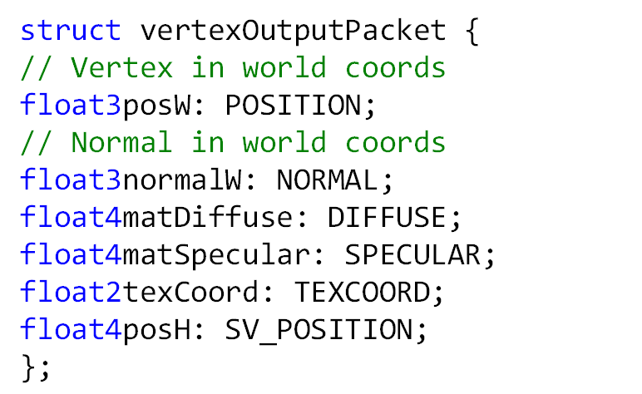
Phong Vertex Shader Output (PS Input)

Slide 9
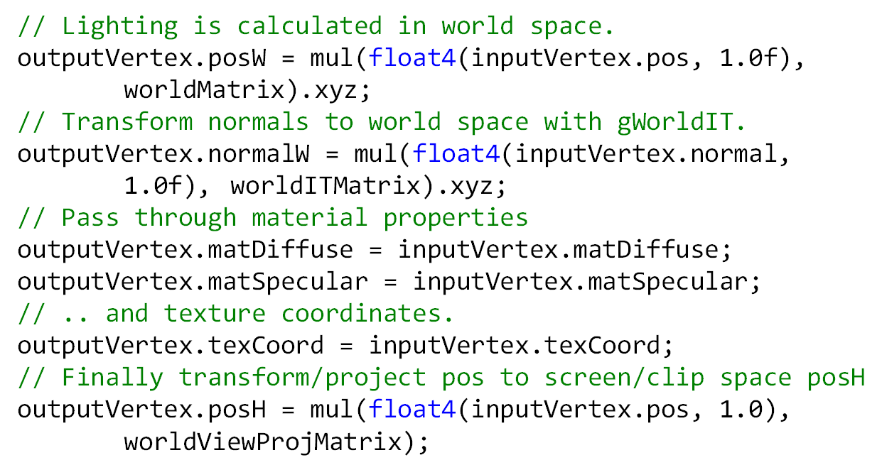
Phong Vertex Shader

Slide 10
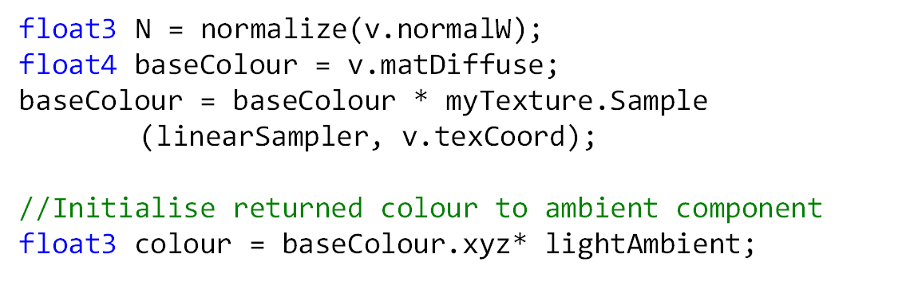
Phong Pixel Shader (Ambient)

Slide 11
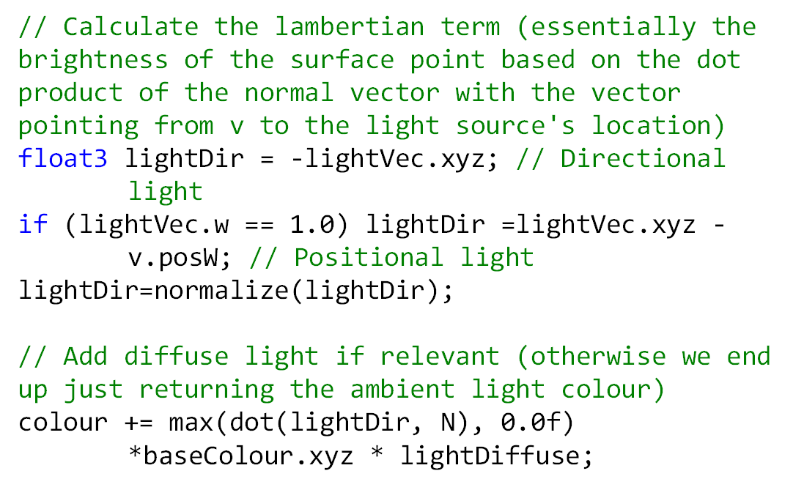
Phong Pixel Shader (Diffuse)

Slide 12
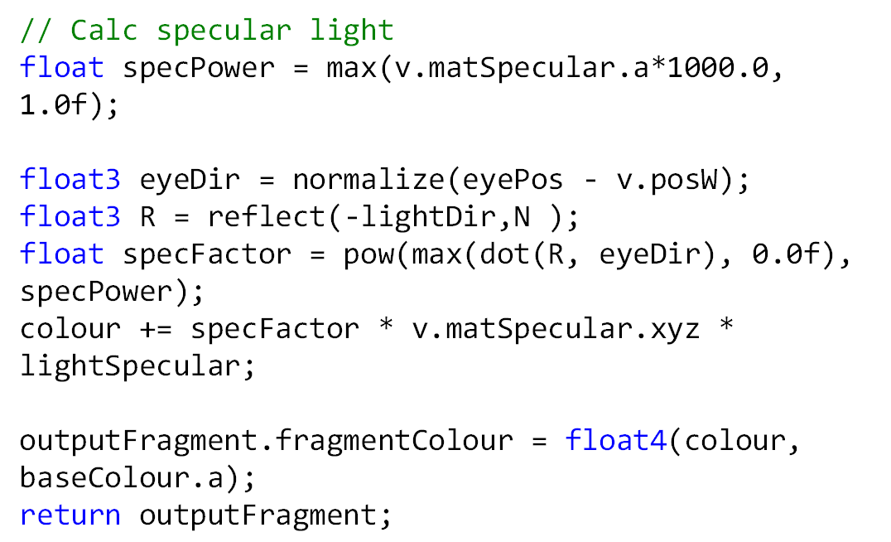
Phong Pixel Shader (Specular)

Slide 13
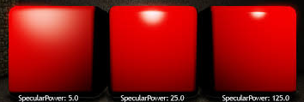
materialPower

